Slide 1
Continuous Random Variables and Probability Distributions
Session 09 - 12
Anom Yudistira

Slide 2
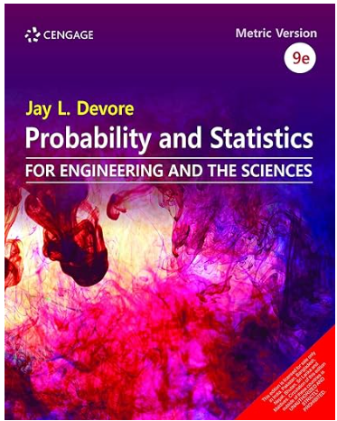
Jay L. Devore. (2020). Probability and Statistics for Engineering and the Sciences, 9E. Cancage Learning, Boston USA. ISBN-13: 978-0-538-73352-6
References

Slide 3
Learning Outcomes
On successful completion of this course, student will be able to:
LO 2: Calculate Descriptive Measures, Probability, Discrete
and Continuous Distribution

Slide 4
Sub Topics
Probability Density Functions
Comulative Distributions Functions and Expected Values
The Normal Distributions
The Exponential Distributions
Others Continuous Distributions
Probability Plots

Slide 5
Learning Objectives
LO 2: Calculate Descriptive Measures, Probability, Discrete and Continuous Distribution

Slide 6
Continuous Random Variables

Slide 7
Continuous Random Variables
Continuous random variables can assume the infinitely many values corresponding to points on a line interval.
Examples:
  Heights, weights
  length of life of a particular product
  experimental laboratory error

Slide 8
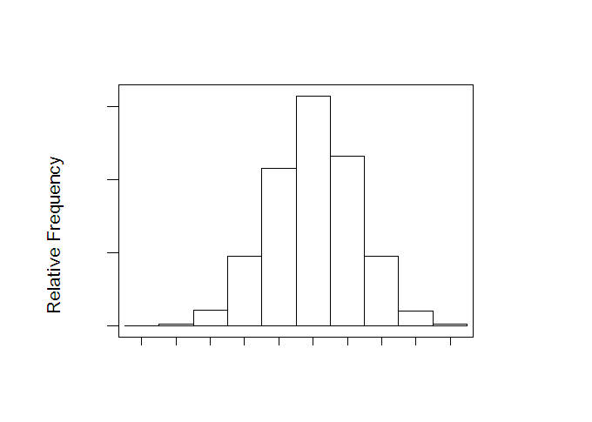
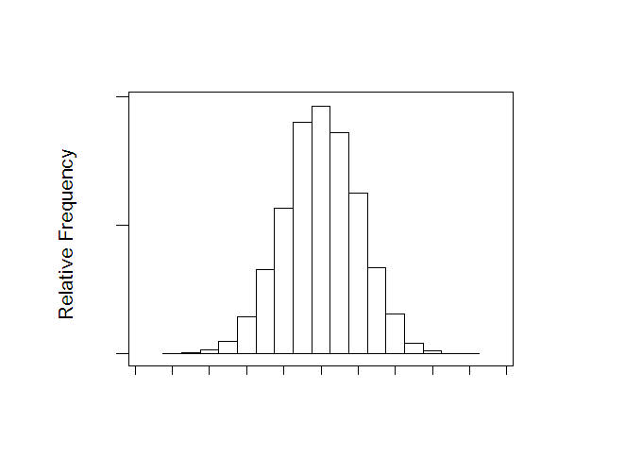
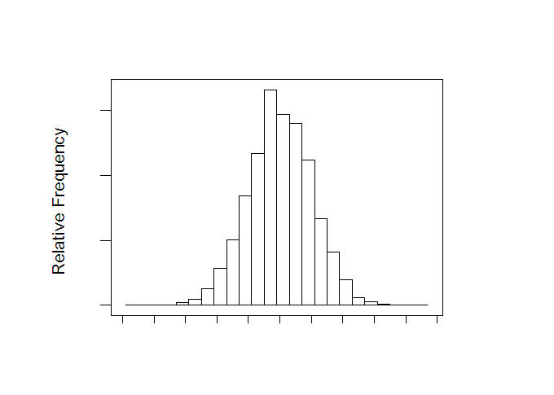
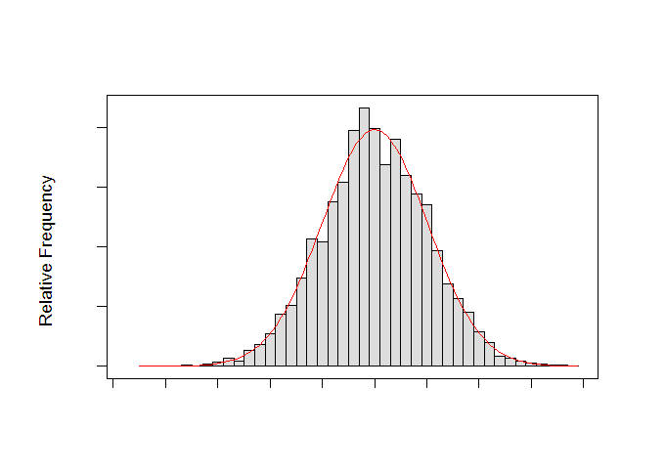
Relative Frequency Histogram
Describing the probability distribution of the continuous RV

Slide 9
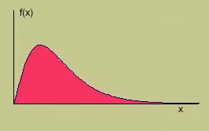
Continuous Random Variables
A smooth curve describes the probability distribution of a continuous random variable.
The depth or density of the probability, which varies with x, may be described by a mathematical formula f (x ), called the probability distribution or probability density function for the random variable x.

Slide 10
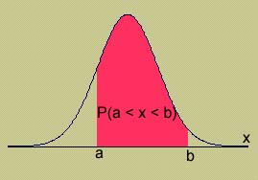
Properties of Continuous
Probability Distributions
The area under the curve is equal to 1.
P(a ≤ x ≤ b) = area under the curve between a and b.
There is no probability attached to any single value of x. That is, P(x = a) = 0.

Slide 11
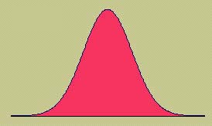
Continuous Random Variables
There are many different types of continuous random variables
We try to pick a model that
  Fits the data well
  Allows us to make the best possible inferences using the data.
One important continuous random variable is the normal random variable.

Slide 12
Probability Density Functions

Slide 13
Probability Distributions for Continuous Random Variables
Suppose the variable X of interest is the depth of a lake at a randomly chosen point on the surface.
Let M = the maximum depth (in meters), so that any number in the interval [0, M] is a possible value of X.
If we “discretize” X by measuring depth to the nearest meter, then possible values are nonnegative integers less than or equal to M.
The resulting discrete distribution of depth can be pictured using a probability histogram.

Slide 14
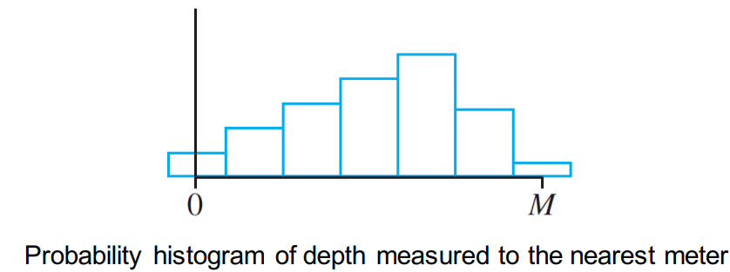
Probability Distributions for Continuous Random Variables
If we draw the histogram so that the area of the rectangle above any possible integer k is the proportion of the lake whose depth is (to the nearest meter) k, then the total area of all rectangles is 1:

Slide 15
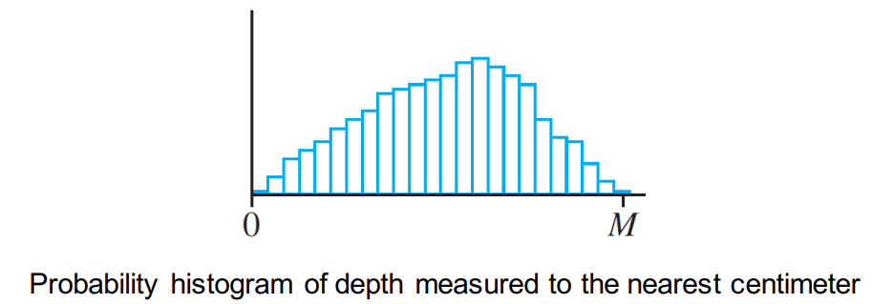
Probability Distributions for Continuous Random Variables
If depth is measured much more accurately, each rectangle in the resulting probability histogram is much narrower, though the total area of all rectangles is still 1.

Slide 16
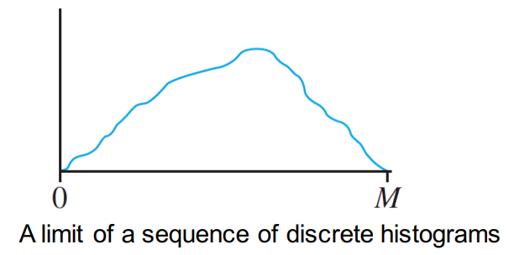
Probability Distributions for Continuous Random Variables
If we continue in this way to measure depth more and more finely, the resulting sequence of histograms approaches a smooth curve.
Because for each histogram the total area of all rectangles equals 1, the total area under the smooth curve is also 1.

Slide 17
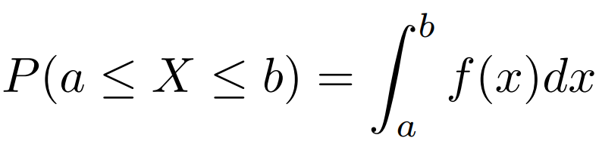
Probability Density Functions
Definition
Let X be a continuous r.v. Then a probability distribution or probability density function (pdf) of X is a function f(x) such that for any two numbers a and b with a ≤ b, we have
The probability that X is in the interval [a, b] can be calculated by integrating the pdf of the r.v. X.

Slide 18
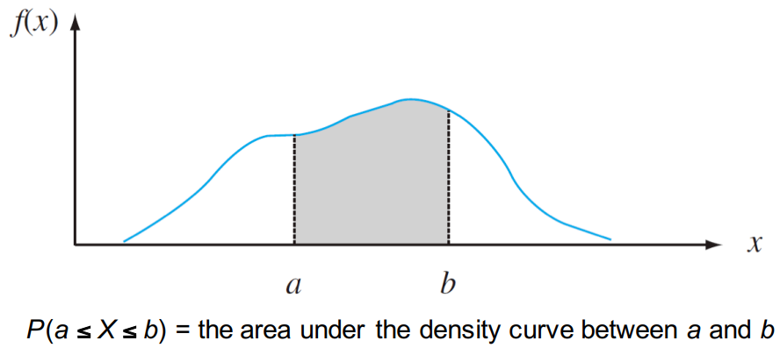
Probability Density Functions
The probability that X takes on a value in the interval [a, b] is the area above this interval and under the graph of the density function:

Slide 19
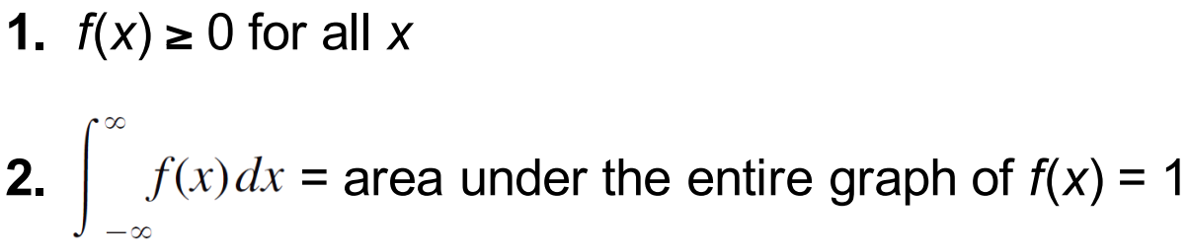
Probability Density Functions
For f(x) to be a legitimate pdf, it must satisfy the following two conditions:

Slide 20
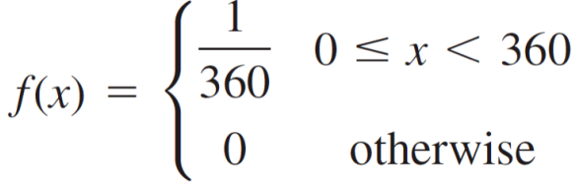
Example
Consider the reference line connecting the valve stem on a tire to the center point.
Let X be the angle measured clockwise to the location of an imperfection. One possible pdf for X is

Slide 21
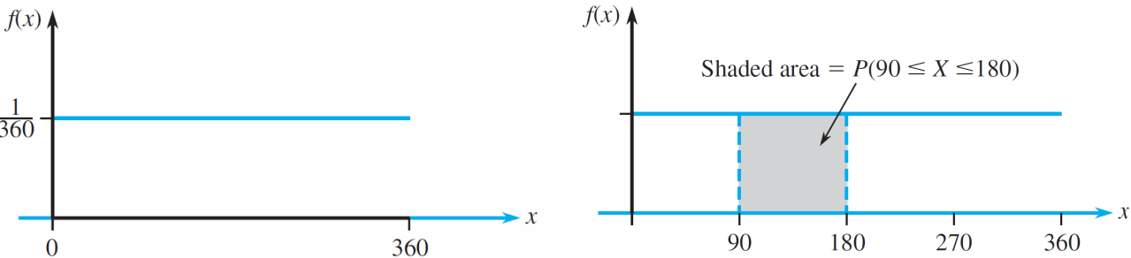
Example
The pdf is graphed in the following figure.

Slide 22

Example
Clearly $f(x)≥0$. How can we show that the area of this pdf is equal to 1?
How do we calculate $P(90 ≤ X ≤ 180)$?
The probability that the angle of occurrence is within 90° of the reference line (reference line is at 0 degrees)?

Slide 23
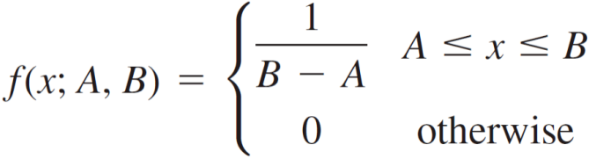

Probability Distributions for Continuous Variables
Because whenever $0 ≤ a ≤ b ≤ 360 o$n the previous Example and $P(a ≤ X ≤ b)$depends only on the width b – a of the interval, X is said to have a uniform distribution.
Definition
A continuous rv X is said to have a uniform distribution on the interval [A, B] if the pdf of X is

Slide 24
Comulative Distributions Functions and Expected Values

Slide 25
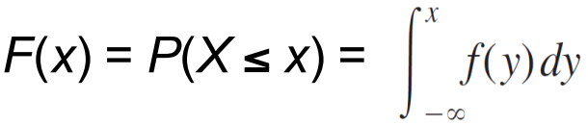
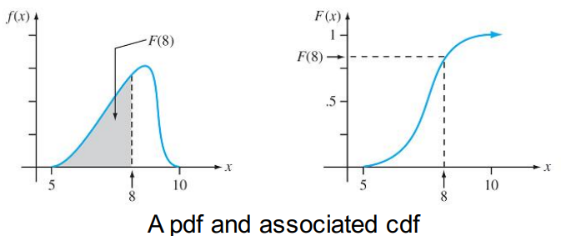
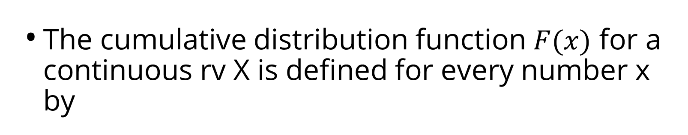
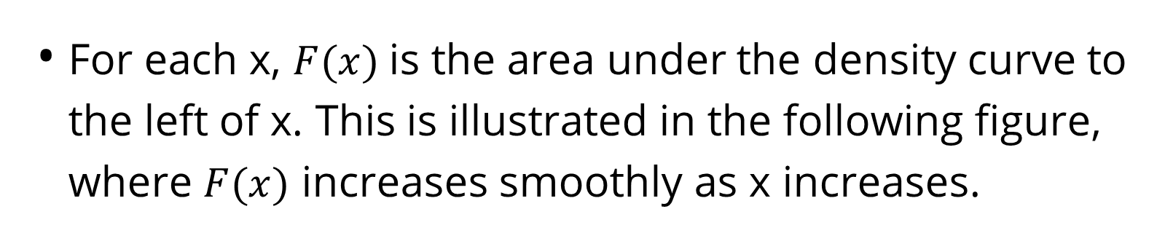
The Cumulative Distribution Function
The cumulative distribution function $F(x)$ for a continuous rv X is defined for every number x by
For each x, $F(x)$is the area under the density curve to the left of x. This is illustrated in the following figure, where $F(x)$ increases smoothly as x increases.

Slide 26
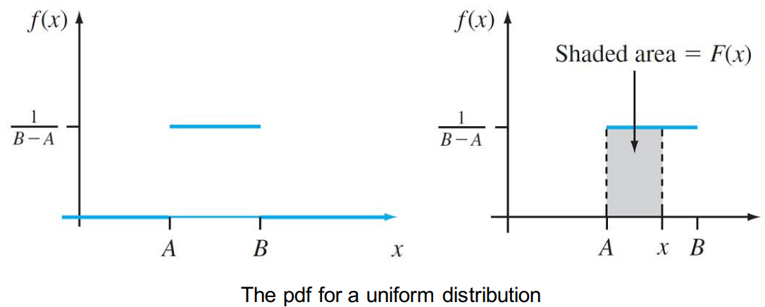
Example
Let X, the thickness of a certain metal sheet, have a uniform distribution on [A, B].
The density function is shown on the following figure.

Slide 27
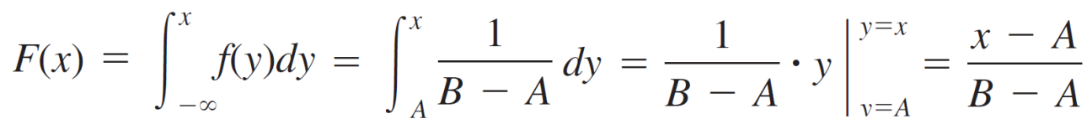

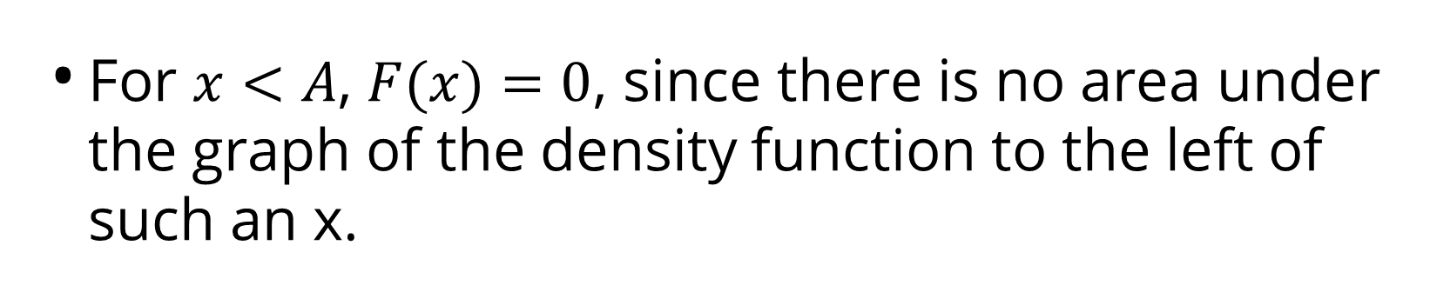
Example
For $x<A$, $F(x)=0$, since there is no area under the graph of the density function to the left of such an x.
For $x≥B$, $F(x)=1$, since all the area is accumulated to the left of such an x. Finally for $A≤x≤B$,

Slide 28
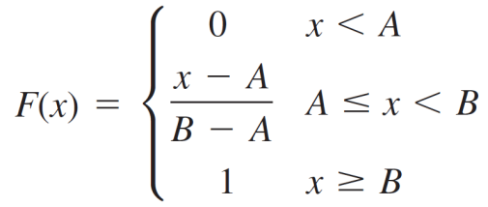
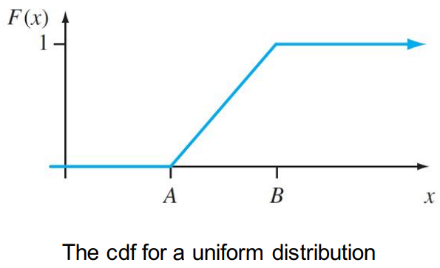
Example
The entire cdf is
The graph of this cdf appears on the following Figure

Slide 29
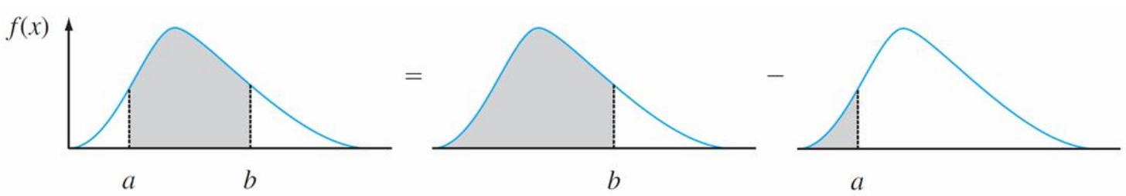
Using F(x) to Compute Probabilities
$$P\left(a<x<b\right)=P\left(x<b\right)−P\left(x<a\right)$$
$P\left(a<x<b\right)=F\left(b\right)−F$(a)

Slide 30
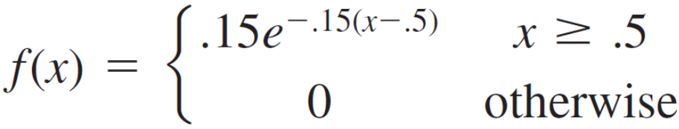
Probability Calculation Example
“Time headway” in traffic flow is the elapsed time between the time that one car finishes passing a fixed point and the instant that the next car begins to pass that point.
Let X : the time headway for two randomly chosen consecutive cars on a freeway during a period of heavy flow.

Slide 31
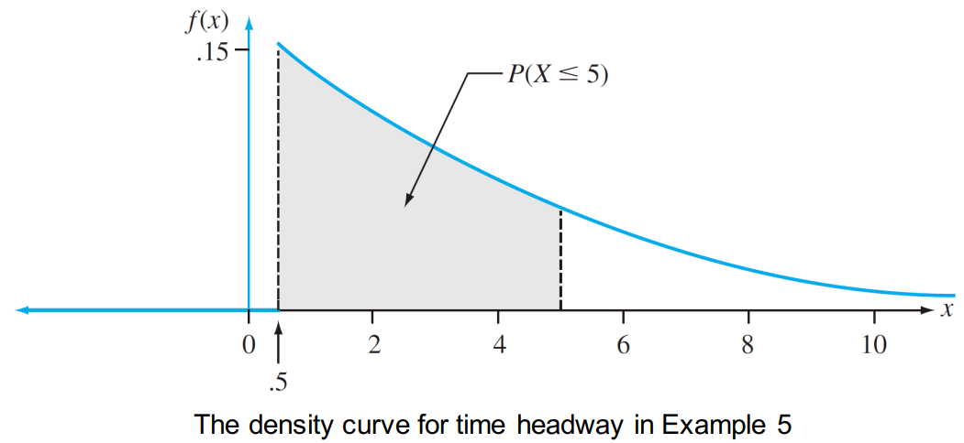
Example
The graph of f(x) is given in the figure below; there is no density associated with headway times less than .5, and headway density decreases rapidly (exponentially fast) as x increases from .5.

Slide 32
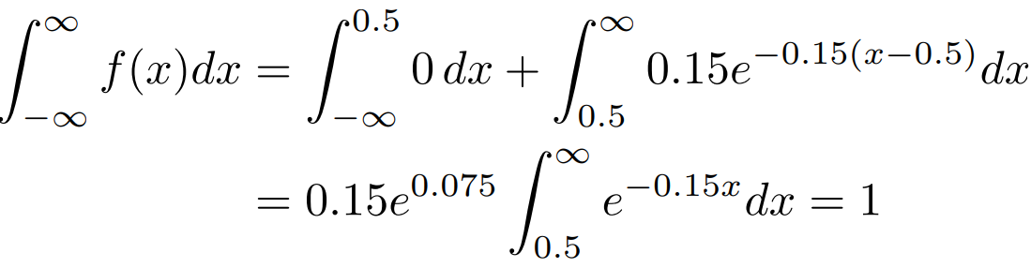
Example
Clearly, f(x) ≥ 0; and
What is the probability that headway time is at most 5 seconds?

Slide 33
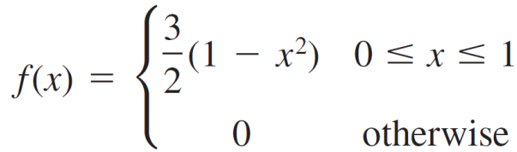
Example
The distribution of the amount of gravel (in tons) sold by a particular construction supply company in a given week is a continuous rv X with pdf
What is the cdf of sales for any x? How do you use this to find the probability that X is less than .25? What about the probability that X is greater than .75? What about P(.25 < X < .75)?

Slide 34
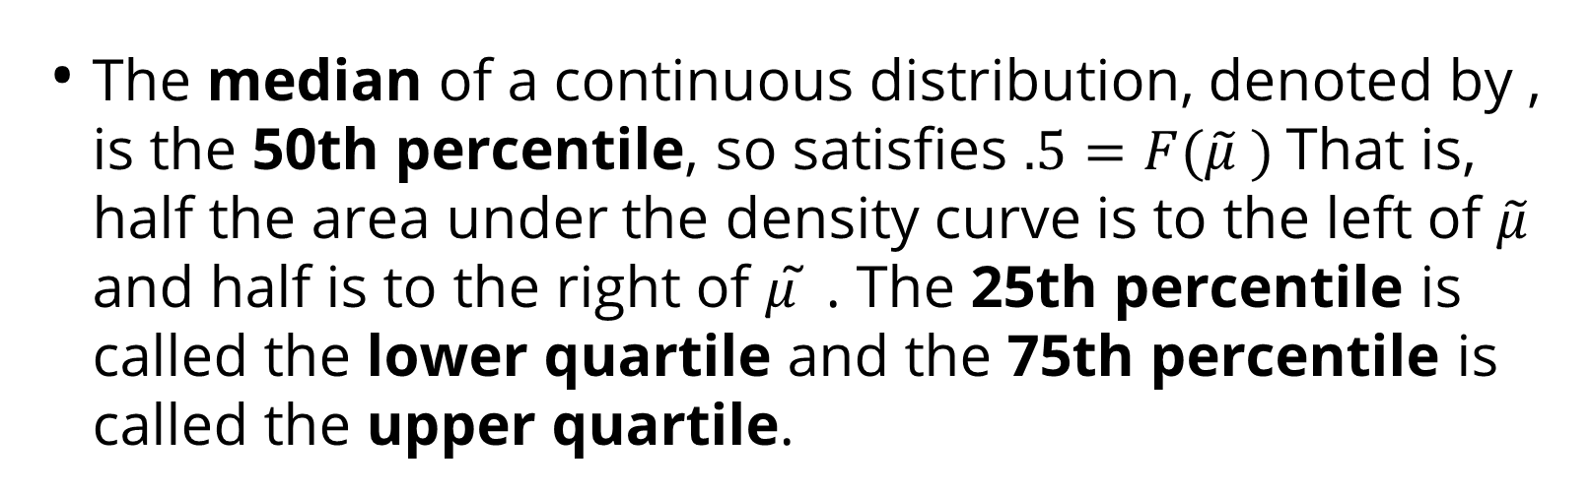
Percentiles of a Continuous Distribution
The median of a continuous distribution, denoted by , is the 50th percentile, so satisfies $.5=F(\tilde{μ} )$That is, half the area under the density curve is to the left of $\tilde{μ}$ and half is to the right of 𝜇 ̃ . The 25th percentile is called the lower quartile and the 75th percentile is called the upper quartile.
When we say that an individual’s test score was at the 85th percentile of the population, we mean that 85% of all population scores were below that score and 15% were above.

Slide 35
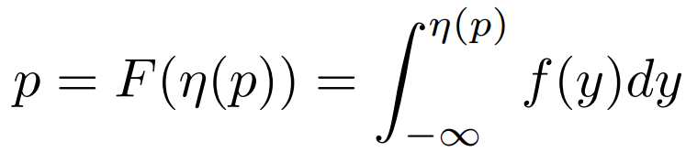
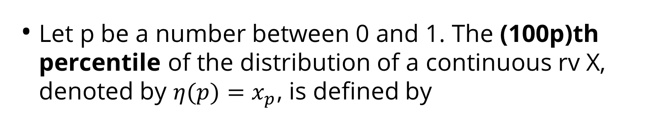
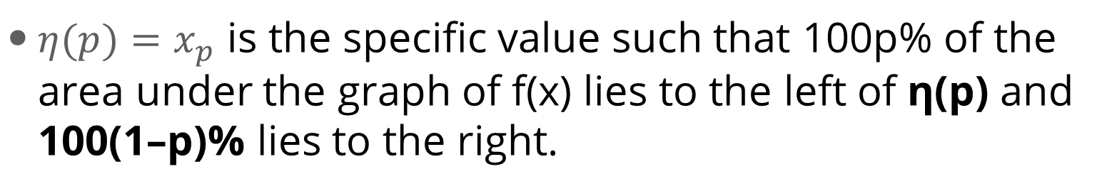
Percentiles of a Continuous Distribution
Let p be a number between 0 and 1. The (100p)th percentile of the distribution of a continuous rv X, denoted by $η(p)=x_{p}$, is defined by
$η(p)=x_{p}$ is the specific value such that 100p% of the area under the graph of f(x) lies to the left of η(p) and 100(1–p)% lies to the right.

Slide 36
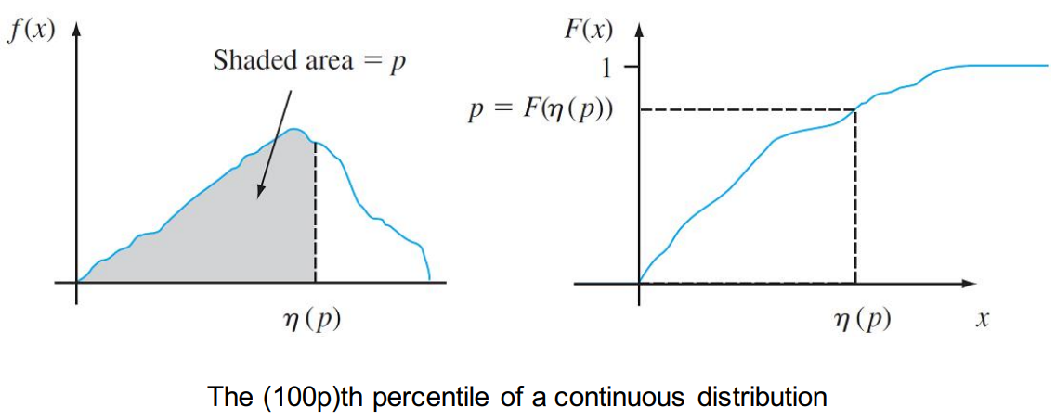
Percentiles of a Continuous Distribution
Thus η(.75), the 75th percentile, is such that the area under the graph of f(x) to the left of η(.75) is .75.
The Figure below illustrates the definition.

Slide 37
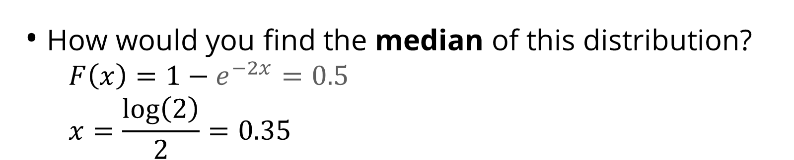
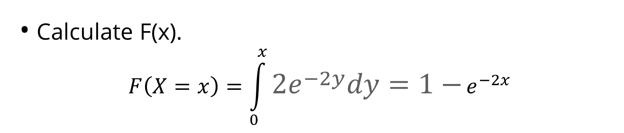
Example
$$f\left(x\right)=2e^{−2x}, x>0$$
Calculate F(x).
$$F\left(X=x\right)=\int_{0}^{x}{2e^{−2y}dy=1−}e^{−2x}$$
How would you find the median of this distribution?
    $$F\left(x\right)=1−e^{−2x}=0.5$$
    $$x=\frac{\log\left(2\right)}{2}=0.35$$
How do we find the 40th percentile of this distribution?

Slide 38
Expected Values

Slide 39
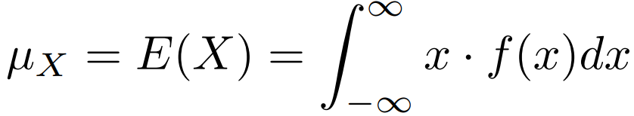
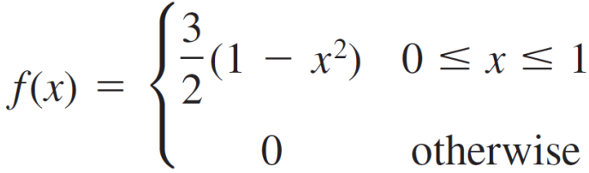
Expected Values
The expected (or mean) value of a continuous r.v. X with the pdf f(x) is:
Example:
  Back to the gravel example, the pdf of the amount of weekly gravel sales X is:
  What is E(X) ?

Slide 40
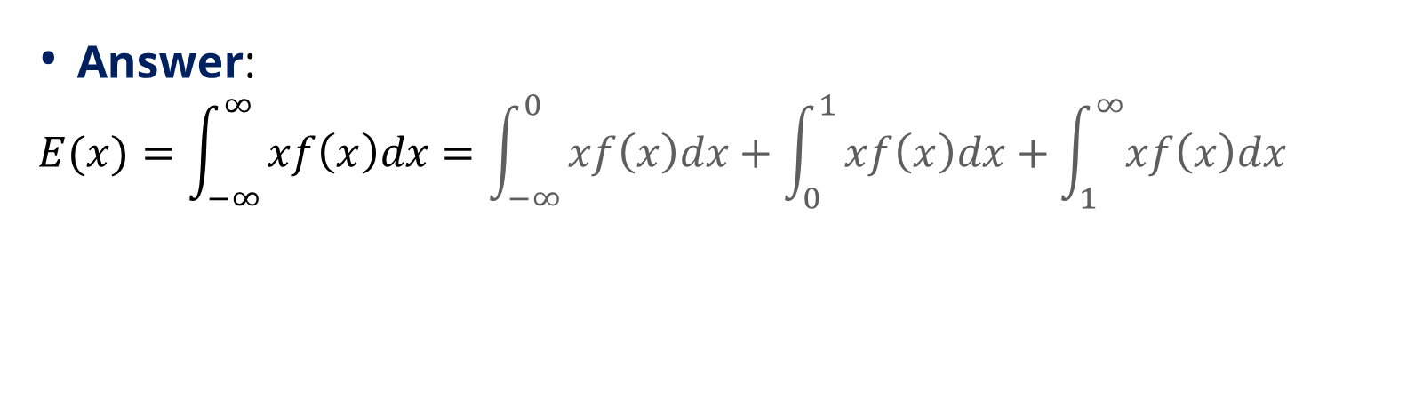
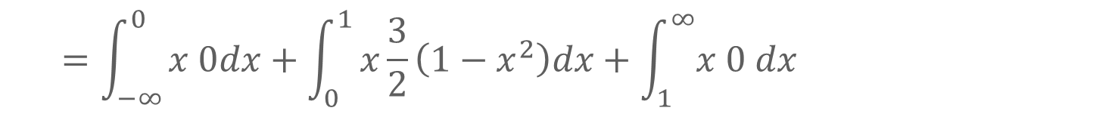
Example …
Answer:
$$E(x)=\int_{−∞}^{∞}{xf\left(x\right)dx=\int_{−∞}^{0}{xf\left(x\right)dx+\int_{0}^{1}{xf\left(x\right)dx+\int_{1}^{∞}{xf\left(x\right)dx}}}}$$
$$=\int_{−∞}^{0}{x 0dx+\int_{0}^{1}{x\frac{3}{2}\left(1−x^{2}\right)dx+\int_{1}^{∞}{x 0 dx}}}$$
  $$E(X) = 3/8 = 0.375$$

Slide 41
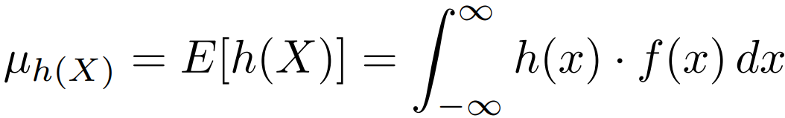


Expected Values of functions of r.v.
If $h(X)$ is a function of X, then
For $h(X)=aX+b$, a linear function,

Slide 42
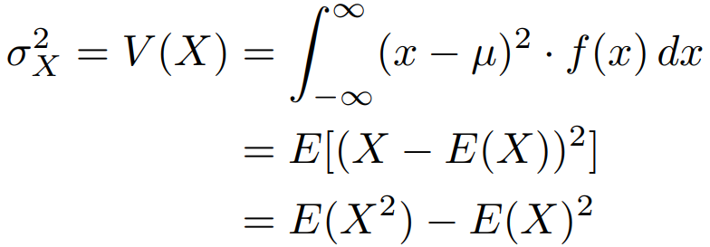

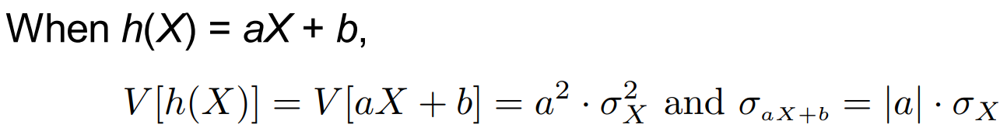
Variance
The variance of a continuous random variable X with pdf f(x) and mean value µ is
The standard deviation (SD) of X is

Slide 43
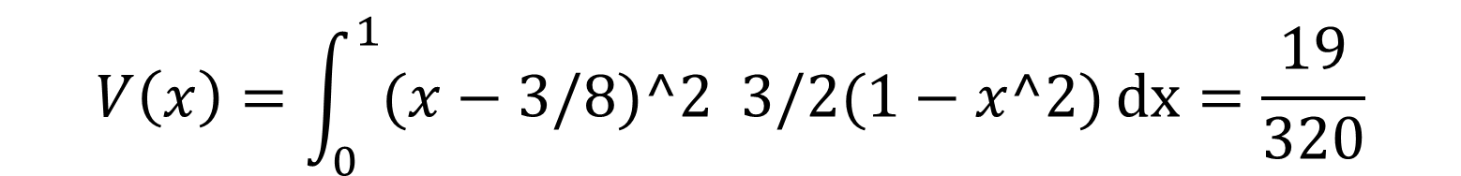
Example
How do we compute the variance for the weekly gravel sales example?
$$V\left(x\right)=\int_{0}^{1}{(x−3/8)^2 3/2(1−x^2)}dx=\frac{19}{320}$$

Slide 44
The Normal Distribution

Slide 45
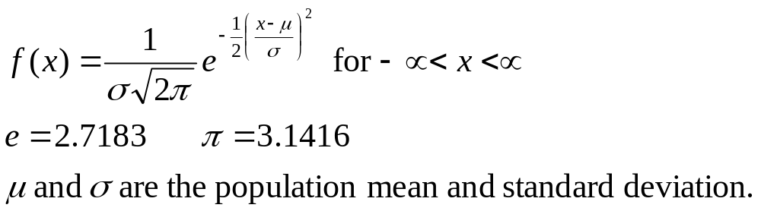
The Normal Distribution
The formula that generates the normal probability distribution is:
The shape and location of the normal curve changes as the mean and standard deviation change.

Slide 46
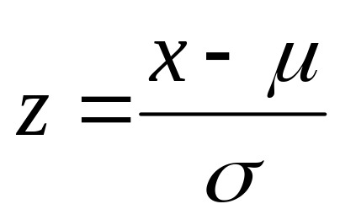
The Standard Normal Distribution
To find P(a < x < b), we need to find the area under the appropriate normal curve.
To simplify the tabulation of these areas, we standardize each value of x by expressing it as a z-score, the number of standard deviations σ it lies from the mean μ.

Slide 47
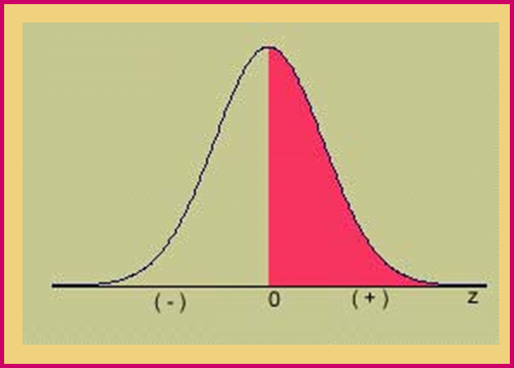
The Standard Normal (z) Distribution
Mean = 0; Standard deviation = 1
When x = μ, z = 0
Symmetric about z = 0
Values of z to the left of center are negative
Values of z to the right of center are positive
Total area under the curve is 1.

Slide 48
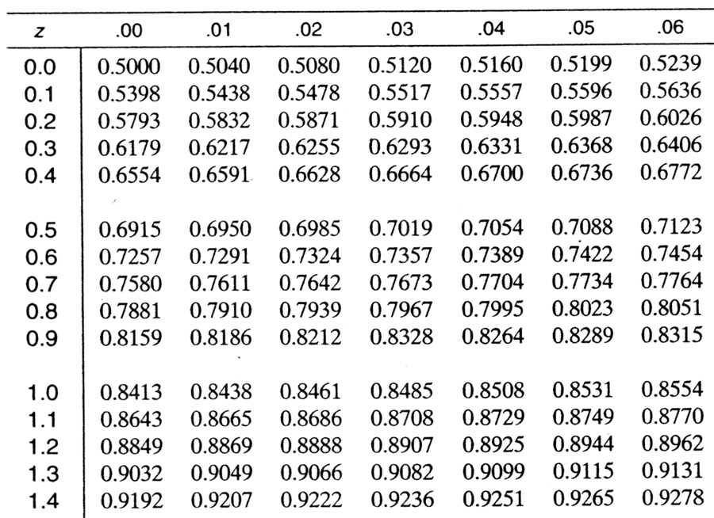

Using Table
The four digit probability in a particular row and column of the Cumulative Standard Normal Table, gives the area under the z curve to the left that particular value of z.
Area for z = 1.36

Slide 49



Example
Use the cumulative Standard Normal Table to calculate these probabilities:
P(z ≤1.36) = .9131
P(z >1.36)
= 1 - .9131 = .0869
P(-1.20 ≤ z ≤ 1.36) = .9131 - .1151 = .7980

Slide 50


Using Table
To find an area to the left of a z-value, find the area directly from the table.
To find an area to the right of a z-value, find the area in Table and subtract from 1.
To find the area between two values of z, find the two areas in Table, and subtract one from the other.
Remember the Empirical Rule: Approximately 99.7% of the measurements lie within 3 standard deviations of the mean.
Remember the Empirical Rule: Approximately 95% of the measurements lie within 2 standard deviations of the mean.
P(-1.96 ≤ z ≤ 1.96) = .9750 - .0250 = .9500
P(-3 ≤ z ≤ 3)
= .9987 - .0013=.9974

Slide 51



Working Backwards
(Percentile)
Find the value of z that has area .25 to its left.
Look for the four digit area closest to .2500 in the Table.
What row and column does this value correspond to?
3. z = -.67
4. What percentile does this value represent?
25th percentile,
or 1st quartile (Q₁)

Slide 52


Working Backwards
Find the value of z that has area .05 to its right.
The area to its left will be 1 - .05 = .95
Look for the four digit area closest to .9500 in the Table.
Since the value .9500 is halfway between .9495 and .9505, we choose z halfway between 1.64 and 1.65.
z = 1.645

Slide 53


Finding Probabilities for the General Normal Random Variable
To find an area for a normal random variable x with mean μ and standard deviation σ, standardize or rescale the interval in terms of z.
Find the appropriate area using Table.
Example: x has a normal distribution with μ = 5 and σ = 2. Find P(x > 7).
1 z

Slide 54




Example
The weights of packages of ground beef are normally distributed with mean 1 pound and standard deviation .10. What is the probability that a randomly selected package weighs between 0.80 and 0.85 pounds?

Slide 55


Example
What is the weight of a package such that only 1% of all packages exceed this weight?

Slide 56

The Normal Approximation to the Binomial
We can calculate binomial probabilities using
  The binomial formula
  The cumulative binomial tables
When n is large, and p is not too close to zero or one, areas under the normal curve with mean np and variance npq can be used to approximate binomial probabilities.

Slide 57

Approximating the Binomial
Make sure to include the entire rectangle for the values of x in the interval of interest. This is called the continuity correction.
Standardize the values of x using
Make sure that np and nq are both greater than 5 to avoid inaccurate approximations!

Slide 58


Example
Suppose x is a binomial random variable with n = 30 and p = .4. Using the normal approximation to find P(x ≤ 10).
n = 30 p = .4 q = .6
np = 12 nq = 18
The normal approximation is ok!

Slide 59



Example

Slide 60


Example
A production line produces AA batteries with a reliability rate of 95%. A sample of n = 200 batteries is selected. Find the probability that at least 195 of the batteries work.
The normal approximation is ok!
Success = working battery n = 200
p = .95 np = 190 nq = 10

Slide 61
Exponential Distribution

Slide 62

The Exponential Distributions
The family of exponential distributions provides probability models that are very widely used in engineering and science disciplines.
X is said to have an exponential distribution with the rate parameter λ (λ > 0) if the pdf of X is

Slide 63



The Exponential Distributions
Integration by parts give the following results:
How would we set up the calculation for $E(X)$?
Both the mean and standard deviation of the exponential distribution equal 1/λ.

Slide 64
The Exponential Distributions
Another important application of the exponential distribution is to model the distribution of lifetimes, or times to an event.
A partial reason for the popularity of such applications is the “memoryless” property of the Exponential distribution.

Slide 65



The Exponential Distributions
Suppose a light bulb’s lifetime is exponentially distributed with parameter λ.
Say you turn the light on, and then we leave and come back after $t_{0}$ hours to find it still on. What is the probability that the light bulb will last for at least additional t hours?
In symbols, we are looking for $P(X≥t+t_{0} | X≥t_{0}).$
How would we calculate this? (Devore, p. 172)

Slide 66
Probability Plots

Slide 67


Sample Percentiles
Order the n sample observations from smallest to largest. Then the ith smallest observation in the list is taken to be the $[100(i−.5)/n]$th sample percentile.
For example, if $n=10$, the percentages corresponding to the ordered sample observations are $\frac{100\left(1−.5\right)}{10}=5\%,\frac{100\left(2−.5\right)}{10}=15\%$, $25\%,…,$and $\frac{100\left(10−.5\right)}{10}=95\%$.
The 10th percentile is then halfway between the 5th percentile (smallest sample observation) and the 15th percentile (second smallest observation).

Slide 68

A Probability Plot
Suppose now that for percentages $100(i−.5)/n (i=1,…, n)$ the percentiles are determined for a specified population distribution whose plausibility is being investigated.
If the sample was actually selected from the specified distribution, the sample percentiles (ordered sample observations) should be reasonably close to the corresponding population distribution percentiles.

Slide 69



A Probability Plot
Let’s consider the (population percentile, sample percentile) pairs—that is, the pairs
for $i=1,…, n$.
Each such pair can be plotted as a point on a two-dimensional coordinate system.
The plotted points will then fall close to a ${45}^{o}$ line. Substantial deviations of the plotted points from a ${45}^{o}$ line cast doubt on the assumption that the distribution under consideration is the correct one.

Slide 70

A Probability Plot

Slide 71


Slide 72
Probability Plots

Slide 73


Variance
Each value a random variable could take is subtracted from its expectation, squared, and weighted by its probability of occurrence
Another notation of variance is $σ^{2}$

Slide 74
Variance
  Example, die throw
  $E\left(X\right)=3\frac{1}{2}$
x
x-E(X)
(x-E(X))²
P(X=x)
Product
1
-2.5
6.25
1/6
1.042
2
-1.5
2.25
1/6
0.375
3
-0.5
0.25
1/6
0.042
4
0.5
0.25
1/6
0.042
5
1.5
2.25
1/6
0.375
6
2.5
6.25
1/6
1.042
Tot
2.918

Slide 75


Variance
  Alternative Formula
V(x) = E($X^{2}) −{(E\left(X\right))}^{2}$

Slide 76
Variance
  Example, die throw
x
x²
P(X=x)
Product
1
1
1/6
1/6
2
4
1/6
2/3
3
9
1/6
1 ½
4
16
1/6
2 2/3
5
25
1/6
4 1/3
6
36
1/6
6
Tot
15 1/6

Slide 77

Variance
  Example, die throw

Slide 78

Standard deviation
  Standard deviation: as in the case of describing data, it is easier to work in standard deviations

Slide 79
The Binomial Probability Distributions

Slide 80

Introduction
Discrete random variables take on only a finite or countably number of values.
Three discrete probability distributions serve as models for a large number of practical applications:

Slide 81

The Binomial Random Variable
The coin-tossing experiment is a simple example of a binomial random variable. Toss a fair coin n = 3 times and record x = number of heads.

Slide 82

The Binomial Random Variable
Many situations in real life resemble the coin toss, but the coin is not necessarily fair, so that P(H) ≠ 1/2.
Example: A geneticist samples 10 people and counts the number who have a gene linked to Alzheimer’s disease.
Coin:
Head:
Tail:
Person
Number of
tosses:
P(H):
n = 10
Has gene
P(has gene) = proportion in the population who have the gene.
Doesn’t have gene

Slide 83
The Binomial Experiment
The experiment consists of n identical trials.
Each trial results in one of two outcomes, success (S) or failure (F).
The probability of success on a single trial is p and remains constant from trial to trial. The probability of failure is q = 1 – p.
The trials are independent.
We are interested in x, the number of successes in n trials.

Slide 84
Binomial or Not?
Very few real life applications satisfy these requirements exactly.
Select two people from the U.S. population, and suppose that 15% of the population has the Alzheimer’s gene.
  For the first person, p = P(gene) = .15
  For the second person, p ≈ P(gene) = .15, even though one person has been removed from the population.

Slide 85
Thank you
R Programming
Februay 2023

Slide 86
References
Jay L. Devore. (2020). Probability and Statistics for Engineering and the Sciences, 9E. Cancage Learning, Boston USA. ISBN-13: 978-0-538-73352-6

